Slide 1

MODELLING OF ESTABLSIHING EMERGENCY COMMUNICATION DURING NATURAL DISASTER THROUGH SOCIAL NETWORKS
´PROJECT GUIDE: TEAM MEMBERS:
Dr.R.V.S.LALITHA 1:SULAGNA SINHA(21P31A05C4)
Professor 2:SAI SRINIVAS(21P31A05D2)
3:MANORANJAN HATAI(21P31A0597)
4:AJOY BERA(21P31A0569)

Slide 2
OUTLINE
Abstract
Introduction
Problem Statement
Aim &Objectives of the project
Existing system
Proposed System and Advantages
Requirements Specification
Architecture
Technology /Algorithm Used
No of Modules Available
Methodology for each module explanation
Implementation code
UML Diagrams
References

Slide 3
ABSTRACT
Disaster management is a crucial discipline focused on preparing for, responding to, and recovering from disasters—whether they are natural or man-made. The overarching goal of disaster management is to minimize the adverse effects of disasters on human life, property, and the environment. It encompasses several phases: prevention, mitigation, preparedness, response, recovery, and rehabilitation. Effective disaster management involves various stakeholders, including government agencies, non-governmental organizations (NGOs), local communities, and international bodies, all collaborating to create strategies that enhance resilience and sustainability.
The proposed research focuses on establishing faster means of communication using social networks for effective spread of communication. The spread of message communication is analyzed with various networks like asymmetric, weighted and multigraph networks. Also, network dynamics in Egocentric networks and Complete networks are explored with centrality measures for accelerating effective means of communication
Keywords: Disaster management, Social networks, Graph theory, Asymmetric network, Centrality measures, Egocentric networks and Complete networks

Slide 4
INTRODUCTION
Disaster management is a crucial discipline focused on preparing for, responding to, and recovering from disasters—whether they are natural or man-made. The overarching goal of disaster management is to minimize the adverse effects of disasters on human life, property, and the environment. It encompasses several phases: prevention, mitigation, preparedness, response, recovery, and rehabilitation. Effective disaster management involves various stakeholders, including government agencies, non-governmental organizations (NGOs), local communities, and international bodies, all collaborating to create strategies that enhance resilience and sustainability. Furthermore, disaster management emphasizes the significance of planning and preparedness, which can significantly reduce the impact of disasters when they occur. Many governments and organizations are utilizing data analytics, geographic information systems (GIS), and real-time communication tools to enhance their disaster preparedness and response strategies

Slide 5
PROBLEM STATEMENT
Lack of Early Warning and Preparedness:-
Inadequate forecasting systems for disasters like earthquakes and tsunamis
Poor dissemination of warning information to vulnerable communities
Coordination and Communication Gaps:-
Poor coordination between government agencies, NGOs, and international bodies
Inefficiency in sharing real-time information among response teams
Data Collection and Management Issues:-
Lack of accurate and real-time disaster data for decision-making
Inconsistent data-sharing policies among organizations
Challenges in Search and Rescue Operations:-
Difficulty accessing disaster-hit areas due to debris, floods, or landslides
Lack of trained personnel and advanced rescue equipment

Slide 6
AIM & OBJECTIVES
Aim:
The primary aim of disaster management is to reduce the impact of disasters on human life, infrastructure, and the environment by implementing effective strategies for prevention, preparedness, response, and recovery. It seeks to enhance resilience and ensure a coordinated approach to disaster mitigation and relief efforts.
Objectives:
Preparedness: Develop early warning systems, emergency response plans, and training programs for effective disaster response.
Technology Integration: Utilize advancements such as GIS, remote sensing, and AI for efficient disaster prediction and management.
Recovery and Rehabilitation: Restore affected communities through rebuilding infrastructure, providing psychological support, and reviving economic activities.

Slide 7
EXISTING SYSTEM
SYSTEM: Rely heavily on manual methods to compile and disseminate information about flood-prone areas, safe zones, and rescue team contacts. Modern advancements, such as the Django framework and Python libraries, can enhance these systems significantly
Data Collection:
Source: Historical flood data from meteorological departments and real-time data from IoT sensors and APIs like OpenWeatherMap.
Volume: Over 5,000 flood incidents tracked annually across regions prone to natural disasters.
Tools: Python libraries like Requests for API calls and Django for scraping additional data sources.
Data Processing:
Categorization:
Flood Zones: Identified using GeoPy for location mapping and historical flood patterns from the past decade.
Safe Zones: Automatically calculated based on elevation (e.g., >10 meters from flood levels) and distance criteria (e.g., within 5 km of affected regions).

Slide 8
PROPOSED SYSTEMS
System: A web-based disaster management system using Python with the Django framework to provide real-time safe zone information, transport routes, and rescue team contacts during floods.
Dataset:
Database of over 3,500 safe zones and rescue teams.
Real-time flood data integrated from public APIs and IoT devices.
Automated Safe Zone Identification:
Fully automated system to identify and display nearby safe zones for individuals in flood-affected areas using geolocation services.
Real-Time Data Integration:
Utilizes APIs like OpenWeatherMap to fetch live weather and flood data, updating safe zone information every 15 minutes.
Advanced Mapping and Visualization:
Employs Python libraries such as GeoPy and Folium for accurate mapping and visualization of flooded areas, safe zones, and transport routes.

Slide 9
REQUIREMENT SPECIFICATION
1. Software Requirements:
Development Environment
Programming Language: Python
IDE/Code Editor: VS Code or any preferred IDE
Version Control: Git, Github
Database: PostgreSQL (with PostGIS for GIS mapping), MySQL, or SQLite
2. Hardware Requirements:
Development Hardware
Processor: Intel i5 (minimum) or i7+ / AMD Ryzen 5+
RAM: At least 8GB (16GB+ recommended for GIS and ML tasks)
Storage: SSD (256GB minimum, 512GB+ preferred) for faster performance
Graphics Card: Not mandatory, but a dedicated GPU (NVIDIA GTX/RTX) is useful for ML-based analysis

Slide 10
ARCHITECTURE
Input Stage
Government sources
Place using geolocation
Output Stage
Safe Places
Processing Stage
Data Management
User Interaction
Location Matching
Output Stage
Relocation
Advice
Processing Stage
Alert System
User Interaction
User Input

Slide 11
TECHNOLOGIES/ALGORITHM USED
This project leverages Python for backend development and data processing, utilizing framework Django. It incorporates social network analysis to extract insights from social media for disaster preparedness and precautionary measures. The system employs semantic web technologies to enhance data interoperability and understanding.
Additionally, graph theory and network analysis are applied to model relationships and patterns within disaster related data.PostGIS is used for geospatial data management, while GIS mapping tools like Google Maps API facilitate visualization. Real-time alerts are delivered through SMS, email, and push notifications, ensuring timely dissemination of critical information.

Slide 12
DESIGN OF PROPOSED SOLUTION
Project Stages :
Data Collection : Input Stage(government sources)
Data Management(Processing Stage)
Alert System
User Input
Location Matching
Place Using Geolocation
Safe Places(Output Stage)
Relocation Advice

Slide 13
STAGE 1
Data Collection Module(User Input):
The system collects disaster related data from official government agencies and organizations.
Meteorological Departments
India Meteorological Department (IMD) for weather forecasts, cyclone alerts, and rainfall data.
ISRO (Indian Space Research Organisation) for satellite-based climate monitoring.
Disaster Management Authorities
National Disaster Management Authority (NDMA) for real-time disaster alerts.
State Disaster Management Authorities (SDMAs) for local disaster preparedness updates.
Relief and Rehabilitation Agencies for information on response measures.

Slide 14
STAGE 2
Data Management(Processing Stage):
After collecting disaster-related data from government sources, the next stage involves processing and managing the data efficiently for analysis, prediction, and decision-making.
Data Preprocessing
Data Validation:
Ensures accuracy and reliability by cross-verifying data from multiple government sources.
Detects inconsistencies, missing values, and incorrect formats.
Noise Removal:
Filters out redundant, outdated, or irrelevant data.
Applies smoothing techniques for weather and disaster trend data.
Data Transformation:
Converts raw data into standardized formats (CSV, JSON, XML) for further analysis.
Normalization of numerical data (e.g., rainfall, temperature) for uniformity.
Geospatial data transformation (latitude/longitude mapping for GIS integration).

Slide 15
STAGE 3
Preprocessing Stage: Alert System
Sources of Alerts:
Government agencies (e.g., NDMA, IMD, local disaster management authorities).
Seismographic and meteorological data for early disaster detection.
Alert Formatting & Standardization
Message Structuring:
Converts raw alert data into user-friendly, readable formats.
Multi-Language Support:
Translates alerts for different regional users.
Ensures accessibility for local communities.
Geo-Tagging of Alerts:
Associates alerts with latitude/longitude data for GIS mapping.
Helps visualize affected areas for better decision-making.

Slide 16
STAGE 4
User Interaction: User Input and Location Matching
User Registration & Input Collection
User Profile Setup:
Users provide basic details (name, contact, preferred language).
Option to set alert preferences (e.g., flood alerts, earthquake warnings).
Location Input Options:
Manual Entry: Users can enter their location (city, district, GPS coordinates).
Auto-Detection: Uses GPS & IP-based tracking to fetch real-time location.
Multiple Locations: Users can set alerts for multiple locations (e.g., home, workplace)
Risk Analysis & Alert Customization: Matches user location with disaster updates from government databases & satellite data.
Determines risk level (low, moderate, high) based on disaster intensity & proximity.
Prioritizes alerts for users in high-risk zones (e.g., within 5 km of a flood-prone area).

Slide 17
STAGE 5
Safe Place Identification & Relocation Advice using Geolocation:
Nearest Safe Zones & Shelters:
Detects the closest emergency shelters, relief centers, and hospitals.
Provides directions and estimated travel time to the nearest safe location.
Accessibility Considerations:
Identifies routes accessible for pedestrians, vehicles, and emergency responders.
Highlights areas unsafe for travel due to roadblocks or collapsed infrastructure.

Slide 18
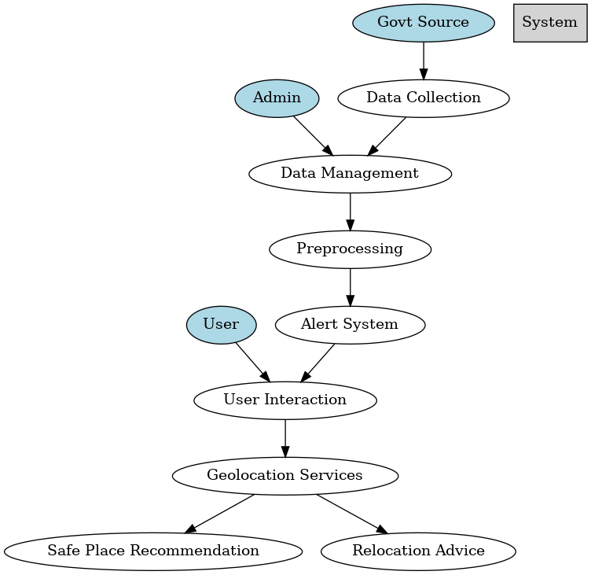
UML DIAGRAM

Slide 19
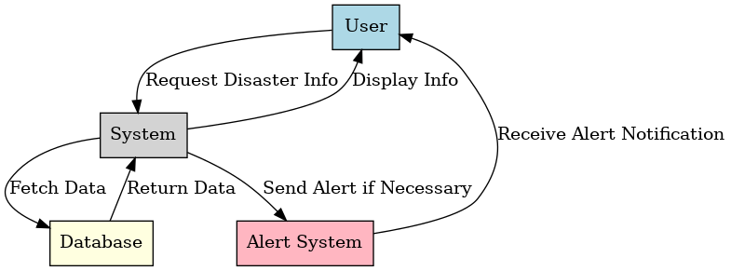
SEQUENCE DIAGRAM

Slide 20
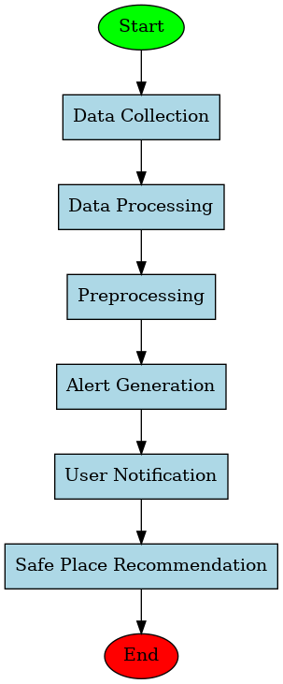
ACTIVITY DIAGRAM

Slide 21
BASIC UI DESIGN & IMPLEMENTATION
Designing a basic UI for a Disaster Management system involves creating a layout that is intuitive, easy to navigate, and focused on providing essential information quickly. Here's a basic outline for the UI elements you might want to include:
Dashboard (Home Screen)Header: App Name (e.g., "Disaster Management Hub")Current location of the user (e.g., "Location: New York")Notifications icon (alerts for nearby disasters)
Main Navigation (Tabs or Menu):
Disasters: List of current disasters (Earthquakes, Floods, Fires, etc.)
Evacuation Plans: Information on nearby evacuation routes and shelters.
First Aid: Tips and instructions for emergency medical assistance.
Resources: Access to supplies (food, water, etc.).
Emergency Contacts: Local emergency services and hospitals.
Map: A live interactive map showing the location of disasters and safe zones.

Slide 22
BASIC UI DESIGN & IMPLEMENTATION
2. Evacuation Plans PageMap of Safe Zones & Shelters: Interactive map showing nearest shelters, hospitals, and safe zones.the distance/time to nearest safe zones based on the user’s location.
3. First Aid PageEmergency Procedures: List of common first-aid procedures (e.g., CPR, bleeding control, burn care).
4. FooterSettings: To manage notifications, user preferences, etc.Feedback: Users can give feedback about the app’s usefulness.Help & Support: A section for FAQs and contact support.

Slide 23
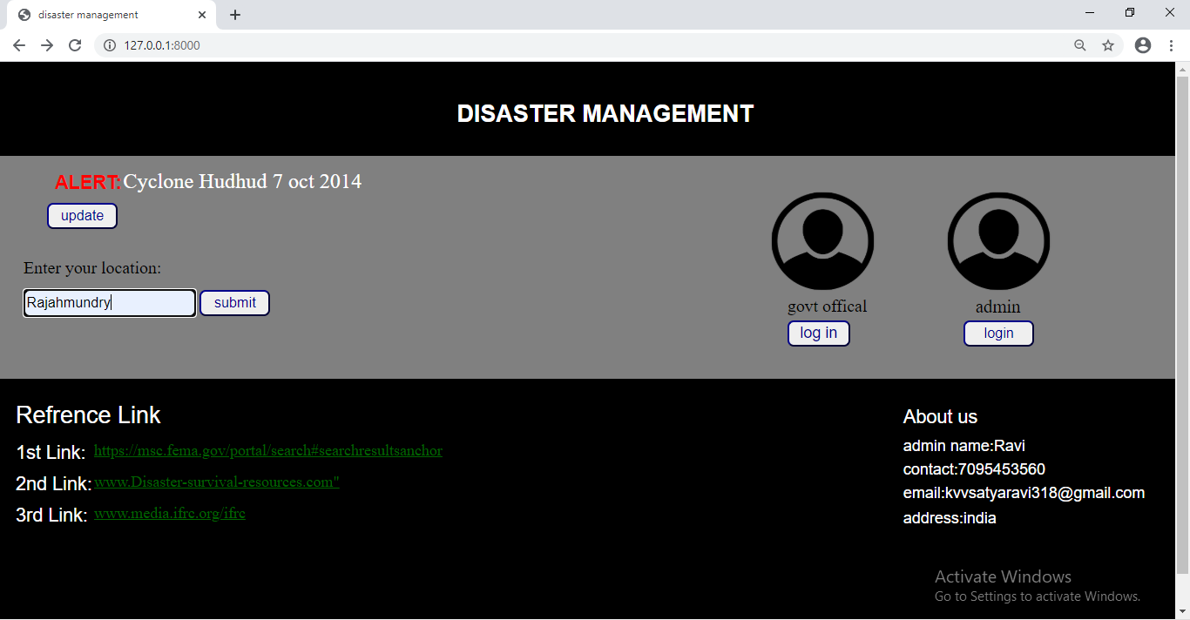
PICTORIAL REPRESENTATION

Slide 24
REFERENCE
Here are some reference sources you can use for a disaster management project
UNDRR (United Nations Office for Disaster Risk Reduction):
Official website: https://www.undrr.org
Provides global policies, frameworks (like the Sendai Framework for Disaster Risk Reduction), and best practices related to disaster management.
World Health Organization (WHO) - Emergency and Disaster Risk Management:
Official website: https://www.who.int/hac/crises/en
Focuses on health aspects of disaster management, including preparedness and response to health emergencies.
IFRC (International Federation of Red Cross and Red Crescent Societies):
Official website: https://www.ifrc.org
Provides resources on humanitarian aid, disaster response, and community resilience.
National Disaster Management Authority (NDMA):
Official website (India): https://ndma.gov.in
Offers resources on disaster management policies, national plans, and preparedness guidelines.
World Bank - Disaster Risk Management:
Official website: https://www.worldbank.org/en/topic/disasterriskmanagement
Provides reports and tools for managing disaster risks, particularly in developing countries.

Slide 25
RESULTS SO FAR
Fast communication with system
Decreases the reaction time
Instant coordinating
Safe places assumed
Death percentage decreases

Slide 26
CONCLUSION
Social networks enable rapid, real-time dissemination of critical information during natural disasters, allowing authorities and communities to stay informed about the evolving situation. This enhances the speed and efficiency of response efforts, reducing confusion and improving coordination.
Social media platforms can reach a broader audience, including vulnerable and remote populations, ensuring that vital alerts and updates are accessible to those who may not have traditional communication channels like TV or radio. This inclusivity strengthens overall disaster response and preparedness.
Social networks facilitate two-way communication, enabling affected communities to share real-time updates, report emergencies, and offer local assistance. This crowdsourced information helps responders make more informed decisions and allocate resources more effectively.

